Slide 1
Human Trafficking
Meghan Torres
Family Café June 2023
Taylor N. Hatch
Director

Slide 2
Notes:
https://cdn.embedly.com/widgets/media.html?src=https%3A%2F%2Fwww.youtube.com%2Fembed%2FGG8QtVSpBMQ%3Ffeature%3Doembed&display_name=YouTube&url=https%3A%2F%2Fwww.youtube.com%2Fwatch%3Fv%3DGG8QtVSpBMQ&image=https%3A%2F%2Fi.ytimg.com%2Fvi%2FGG8QtVSpBMQ%2Fhqdefault.jpg&key=40cb30655a7f4a46adaaf18efb05db21&type=text%2Fhtml&schema=youtube

Slide 3
Human Trafficking
Federal Law: Trafficking Victims Protection Act of 2000 and its subsequent reauthorizations define human trafficking as:
Sex trafficking in which a commercial sex act is inducted by force, fraud, or coercion, or in which the person induced to perform such act has not attained the 18 yrs. of age;
The recruitment, harboring, transportation, provision, or obtaining of a person for labor or service, using force, fraud, or coercion for the purpose of subjection into involuntary servitude, peonage, debt bondage, or slavery. (22 U.S.C. 7102 § (9))
Minors induced into commercial sex are human trafficking victims regardless of force, fraud or coercion is present.
Florida Statute Chapter 787.06(2)(d) - Transportation, soliciting, recruiting, harboring, providing, enticing, maintaining, or obtaining another person for the purpose of exploitation of that person.
Notes:
Definition of Human Trafficking: go over and read

Slide 4
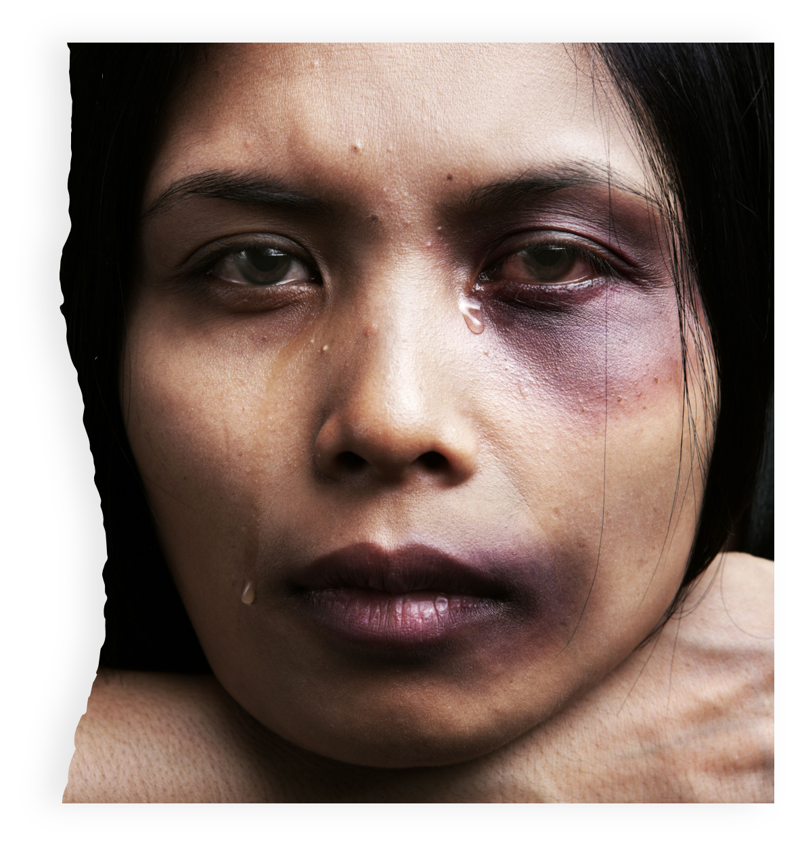
Human Trafficking Statistics
Human trafficking is the third largest international crime and is a $15.5 billion industry in industrialized countries.
While labor trafficking happens all over the world and in developed countries like the U.S., it is less reported than sex trafficking.
Notes:
2 (Polaris Project, n.d.)
- Third largest industry in international crime, behind illegal drugs and fire arms trafficking.
- According to a study completed by the international Labour Organization (ILO) there are approximately 26.6 million people are being trafficked each year.

Slide 5
National Ranking for Human Trafficking in the U.S.
1. California
2. Texas
3. Florida
4. Illinois
Notes:
-According to a study of U.S. Department of Justice human trafficking task force cases, 83 percent of sex trafficking victims identified in the United States were U.S. citizens.
-According to the National Human Trafficking hotline, Florida is ranked #3 in the nation, behind California and Texas.
(Kelly, 2019; National Human Trafficking Hotline, n.d.; Office on Trafficking in Persons, 2019)

Slide 6
Worldwide and National Statistics
According to the US Department of State, 24.9 million people are trafficked at any given time.
77% of victims are trafficked in their countries of residence.
40% of sex trafficking and 20% of labor trafficking cases involved victims who were U.S. citizens.
Women were victims in 85% of sex trafficking cases and men in 40% labor trafficking cases.
Children are involved in 33% of sex trafficking cases and 20% labor trafficking cases.
Males are historically undercounted.
Notes:
According to the US Department of State, 24.9 million people trafficked at any given time. This number has been increasing over the last few years.
3. Bullet 1 International Labour Organization, 2017).
4.(Bullet 2-4)Polaris Project, n.d.
5. Male comment (Kelly, 2019; National Human Trafficking Hotline, n.d.; Office on Trafficking in Persons, 2019)

Slide 7
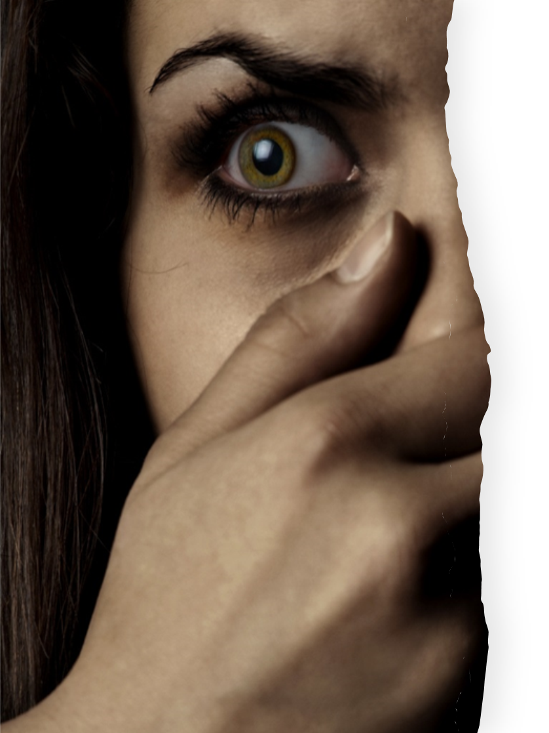
Human Trafficking Elements
FORCE: Beating, Burning, Torture Practices, Sexual Assault, Seasoning
FRAUD: False Promises, Withholding Wages, Blackmail, Extortion, Deceitful Behavior
Notes:
More HT descriptions are..

Slide 8
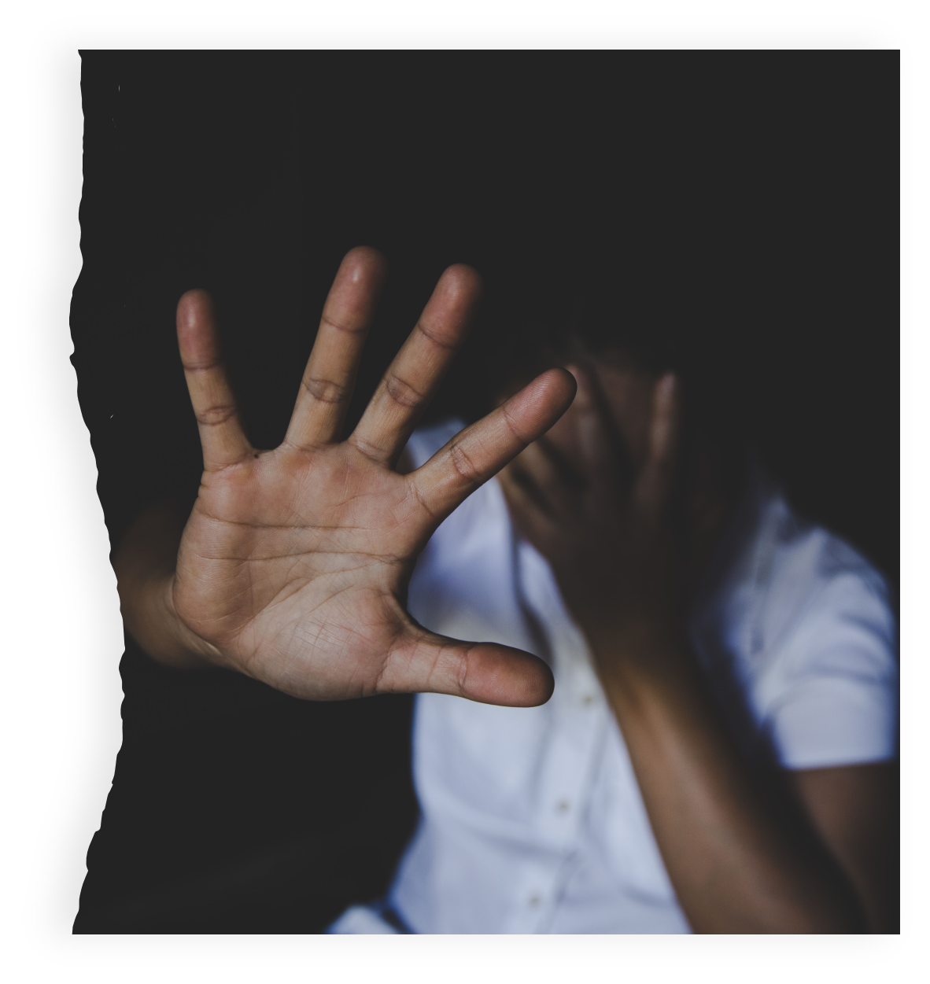
Human Trafficking Elements, cont.
COERCION: Threats of Serious Harm, Intimidation/Humiliation, Emotional Abuse, Creating Dependency, Quotas
ENTICEMENT: False Promise of Love or Friendship, Guilt/Shame, Wanting to Please, Promises of Money/Reward, Protection, Fear

Slide 9
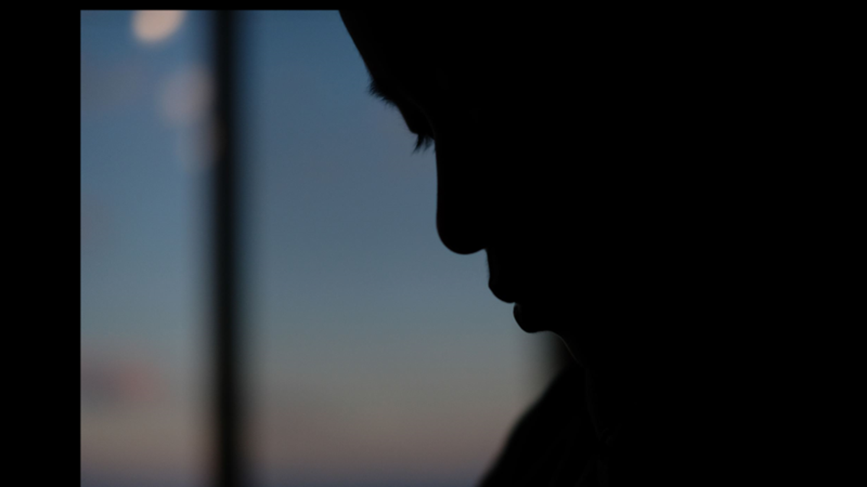
Types of Human Trafficking
LABOR: Agriculture, Begging, Tourism, Nail Salon, Factory Labor
SEX: Prostitution, Brothels, Clubs, Massage Parlors, Escort Services
DOMESTIC SERVITUDE: Nanny, Live-in Maid, Cook, Landscaper, Butler
Notes:
Traffickers do not have one type of profile: They can be Pimps, Intimate partners/family members, Gangs, Criminal networks, Brothel and fake massage business owners and managers, Growers and crew leaders in agriculture, Labor brokers, Employers of domestic servants, Small business owners and managers, Large factory owners and corporations. (APD HT presentation Meghan Torres)

Slide 10
Common Types of
Human Trafficking
Mate Crime: A faux-friendship strategy used by offenders to exploit those with intellectual disabilities. Mate crime was commonly observed among individuals with intellectual disabilities who, due to isolation and friendliness, are easily targeted and befriended by offenders, then criminally exploited or forced into participation in criminal enterprise.
Cuckooing: This derogatory street term describes a strategy employed by exploitative individuals who may move into the home of an individual with an intellectual disability under the guise of being helpful, but exploit the relationship to gain access to food, clothes, medications, money, and/or to manipulate individuals to participate in criminal activities including sex crimes and prostitution.
Notes:
Joan Reid Sex Trafficking of Girls with Intellectual Disabilities: An exploratory Mixed Methods Study USF
(Grundy, 2011; Landman 2014)
(Butera, 2013; Equality and Human Rights Commission, 2011)

Slide 11
Risk Factors
Poverty
Lack of Familial Support
Mental Health Concerns
Individuals with Developmental or Physical Disabilities
Health Care Inequality
Notes:
Risk Factors for Human Trafficking:
1. Poverty and lack of familial support and supervision. Children are more vulnerable to trafficking when they have no adult support and supervision. (HT Prevention & Intervention FSU)
2. Mental Health Problems or experience addiction to substances, depression and anxiety and PTSD are vulnerable. People who experience mental health concerns, which include addiction to substances, depression, anxiety, and post-traumatic stress disorder can create a vulnerability to being trafficked. (Altun et al., 2017)
3. Individuals with ID or physical disabilities are vulnerable. Individuals who have developmental and/or physical disabilities are more vulnerable to trafficking, especially when they lack resources, knowledge about trafficking, and economic support.
4. Individuals who do not have access or adequate health care are vulnerable as well.

Slide 12
Recruiting Tactics
American Dream
Selling False Love
Luxury Items
Grooming
Breaking Down
Seasoning
Force/Abduction
Notes:
During the recruitment stage, traffickers use different types of tactics to employ against an individual. Above are only a few examples.
Traffickers rely on a victim’s motivation for a better life. Victims are usually recruited in their own home country and same nationality as the victim. Victims hear about the opportunity through social networks and are often unaware of the nature of the job. Victims enters a country on a legal guest worker/other visa or are smuggled in illegally. They make false promises to victims about job duties and conditions, immigration benefits, living conditions and compensation. (Polaris Project, 2017)
Traffickers provide warmth, gifts, compliments of sexual or physical intimacy, they elaborate promises of better life, fast money and future luxury
The list above are other tactics they use to get additional victims.
“Grooming,” Breaking-down,” or “Seasoning” these tactics often involve:
Beating/slapping/
whipping
Burning
Sexual Assault
Confinement
Other torture techniques
Emotional abuse
Re-naming
Traffickers want to instill a climate of fear and remove familiarity and support structure from the victim
Force or abduction is not as commonly used when recruiting victims as a more romantic and friendly grooming method. (Polaris Project, 2017)

Slide 13
Vulnerable Populations
and Communities
Research has identified multiple vulnerable populations/communities. A few of these populations are:
Women
Marginalized racial or ethnic groups
Low-income individuals and families
Individuals who are incarcerated or have been incarcerated
Individuals with disabilities
Individuals with mental health conditions
Children
Runaway youth and young adults
Seniors
Immigrants and refugees
Individuals who are limited English proficient
Combinations of these populations
Notes:
(National Academies of Sciences, Engineering, and Medicine et al., 2017).

Slide 14
Increased Risks
A common misperception is that individuals with intellectual or developmental disabilities are not sexually active, which elevates their susceptibility to sex trafficking. Girls with intellectual or developmental disabilities may be assumed to be virgins, leaving them a target for sex trafficking for those seeking to buy or sell sex with a virgin.
Notes:
Joan Reid Sex Trafficking of Girls with Intellectual Disabilities: An exploratory Mixed Methods Study USF
Groce, 2004; Phasha & Myaka, 2014; Reid, Huard, & Haskell, 2014)

Slide 15
Increased Vulnerability
Some individuals with developmental disabilities are more likely to be victimized because of the perception of a social stigma, inability to assess danger until it is at crisis level, and lack of sexual education. A few examples are:
Unable to report the crime
Not considered credible reporters
May be socially isolated
Lack of economic independence
Dependence on others for long-term care
Unable to differentiate between appropriate and inappropriate touching
Lack of participation in abuse awareness and personal safety programs

Slide 16
General Red Flags
Under 18 and providing commercial sex acts
Is in the commercial sex industry and has a pimp or manager
Works excessively long or unusual hours
Not allowed breaks or suffers under unusual restrictions at work
Owes large debt and is unable to pay it off
Recruited through false promises concerning the nature and condition of work
High security measures exist in the work or living conditions (opaque, boarded up, bars on windows, barbed wire, security cameras, etc.)
Does not have possession of personal identification and/or travel documents
Cannot move around freely

Slide 17
General Red Flags, cont.
Lives with a large number of people who are not family
Is always accompanied by a third party
Always lets another person speak for them
Is not allowed to contact their friends or family
Shows signs of physical and/or sexual abuse
Has brands or intentional scarring on their body
Appears malnourished, sleep-deprived, or weak
Displays paranoid behavior
Acts fearful, depressed, submissive, uncooperative, or tense when speaking with law enforcement
Owns expensive or high-end goods that they can not afford on their own

Slide 18
Red Flags for Individuals
with Disabilities
Interest (romantic or friendly)
Change in behavior and physical appearance
Refusal of health care and neglecting medical treatment
Someone attempting to remove/distance/isolate the individual from their supports
Lack of access to personal and/or financial documentation and assets, etc.
Notes:
It is important to know that not everyone in the individual’s life has good intention. Traffickers are more likely to be family members, friends, romantic partners, and even paid supports. Recognizing the role each person plays in the individual’s life helps identify if someone has nefarious intentions.
1. A new person of interest comes along and is moving too quickly than socially acceptable
2. Change in behavior and physical appearance can indicate abuse and/or neglect.
3. Refusal of health care and neglecting medicinal routines can be a red flag . At times they can appear malnourished or can show physical signs of physical abuse or restraint.
4. Someone attempting to remove, distance or isolate an individual from their supports.
5. Lack of access to personal and financial documentation and unusual or new spending habits

Slide 19
Behavioral Signs of Abuse
CHANGES in the way affection is shown, especially if unusual or inappropriate
Sudden fear of being touched
Sudden onset of nightmares
CHANGES in sleep patterns; difficulty sleeping
Sudden regression to childlike behaviors (i.e., bed-wetting, thumb-sucking)
Sudden unusual interest in or knowledge of sexual matters
Cruelty to animals
Sudden fear of bathing or toileting
Sudden fear of a person or place
Depression, withdrawal, or mood swings
ANY UNEXPLAINED CHANGE IN BEHAVIOR
Notes:
The same red flags of Human Trafficking apply to individuals with intellectual and developmental disabilities. However, it may be more difficult to identify these red flags for a variety of reasons. Some individuals rely on others to manage funds, assist in communication, provide medical and physical support, etc. Each individual is unique in their abilities and needs. The rule of thumb is any change in their typical behavior is huge red flag. These changes could be new or increased maladaptive behavior, including sexual, self-injurious, or behavioral outbursts. Sometimes it can appear as fearful, anxious, depressed, submissive, tense, nervous/paranoid, or exhibit unusually fearful or anxious behavior after bringing up law enforcement and avoids eye contact.

Slide 20
Frequent urinary tract infections or yeast infections
Painful urination
Signs of
Sexual
Abuse
Abrasions, bleeding, or bruising in the genital area
Incontinence in someone who was previously toilet-trained
Frequent sore throats
Sudden onset of psychosomatic complaints (males most frequently complain of stomach aches while females most frequently report headaches)
Sudden difficulty walking or sitting
Vaginal or rectal pain

Slide 21
Sudden decrease in bank account balances
Sudden change in banking practices
Signs
of
Exploitation
Sudden problems paying bills or buying food or other necessities
Sudden changes in wills or other financial documents

Slide 22
Difficulties Recognizing
Human Trafficking
Victim does not recognize abuse, neglect, or exploitation
Communication challenges
Some symptoms may be interpreted as behavioral problems or traits of their disability
Victims may be coerced and not appear to be a victim
Some red flags are common with individuals receiving services for intellectual or developmental disabilities
Fear and training prevent disclosing
Notes:
There are difficulties recognizing the signs of Human Trafficking within our population. 1st example on the list is specifically one of our biggest challenges within the community. When attempting to uncover details of the trafficking with a person with intellectual and developmental disabilities it is best to seek out professional assistance. Victims of human trafficking have a wide range of needs after separating from trafficking situations – it is crucial that their varied needs be met by all professionals they encounter, not just trauma-trained social workers. A trauma-informed approach is aimed at understanding the physical, social and emotional impact of trauma on victims of it. Most victims of HT do not communicate the details of the trafficking and display unexpected reactions.
A study was conducted and with females that were ID, and trafficked . (Joan Reid Sex Trafficking of Girls with Intellectual Disabilities: An exploratory Mixed Methods Study USF) So if a person with intellectual disability was trafficked, they would not display trauma symptoms

Slide 23
Prevention of Human Trafficking of Individuals with Disabilities
Enhance
Enhance participation within the community to increase visibility in their communities
Recognize and Address
Recognize and address stigma and discrimination that exists
Learn
Learn the red flags
Report
Report suspected human trafficking
Engage
Engage with support circles and community members to bring awareness and advocacy in human trafficking prevention
Notes:
The most impactful preventative measure for Human Trafficking is training and awareness to the general public. Learning to recognize warning signs, eliminating incorrect stereotypes of people with intellectual and developmental disabilities, and knowing where to report suspicions of human trafficking is critical in protecting individuals from this heinous crime. APD recognizes this preventative measure and its critical role in protecting individuals and has implemented the Zero Tolerance Initiative against abuse, neglect, and exploitation of people with intellectual and developmental disabilities. In this initiative, APD educates staff, service providers, and families in recognizing signs of abuse, neglect, exploitation, and human trafficking.
Here are some protection and prevention strategies above….read.

Slide 24
Mandatory Reporters
EVERYONE in Florida has a responsibility to report known or suspected abuse, neglect, or exploitation.
Failure to report known or suspected cases of child abuse, neglect, or exploitation is a third-degree felony.
Failure to report known or suspected cases of vulnerable adult is a
third-degree misdemeanor.
FLORIDA ABUSE HOTLINE
1-800-962-2873
www.myflfamilies.com

Slide 25
Reporting Suspected
Human Trafficking
Call the Department of Children and Families Abuse Hotline
1-800-962-2873
Call the National Human Trafficking Hotline
1-888-373-7888
Call the Department of Homeland Security
1-866-347-2423 or at www.ice.gov/tips
Call local law enforcement
Notes:
After reporting, what can you expect?
Wrap around services to help the individual feel safe and supported to

Slide 26
Thank You!
Please reach out with questions or additional information.
Meghan Torres
4030 Esplanade Way #380
Tallahassee, FL 32399
850-410-2876
Meghan.Torres@apdcares.org

